Slide 1




Agenda
CREDIT RISK
Ryan
Amelia
Tricia
积极向上团队：

Slide 2

CREDIT RISK, SENTIMENT ANALYSIS & n.P.S.(net Promoter Score)
Tricia

Slide 3
Mini Agenda
Data Cleansing & Quality Check
Correlation
Voluntary Attrition & Sentiment Analysis
Involuntary Attrition & NPS
Conclusion

Slide 4
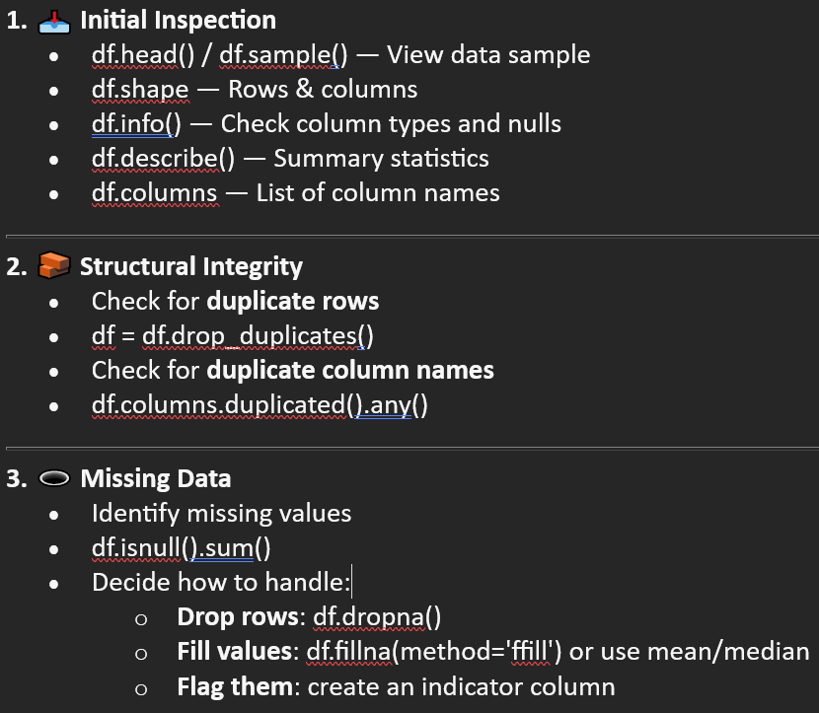
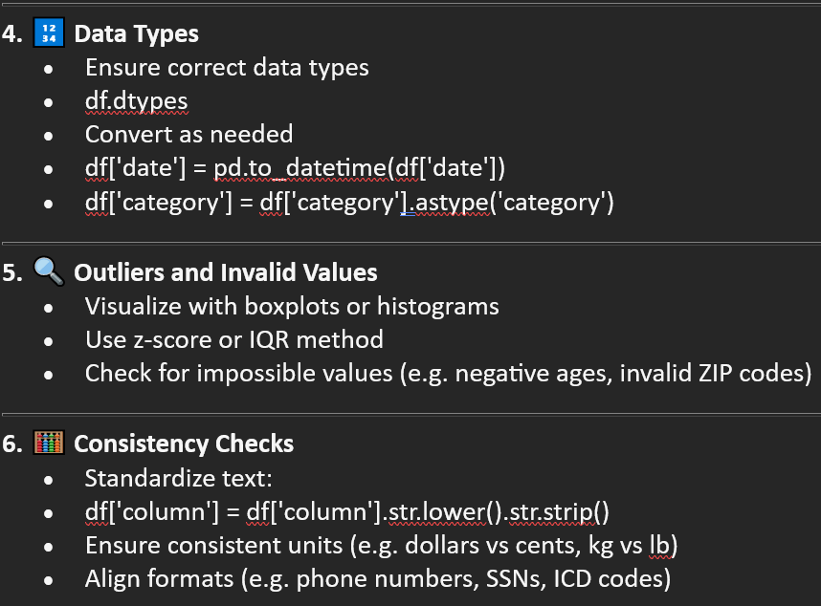
✅ Full List of Data Cleansing / Quality Check Tasks

Slide 5
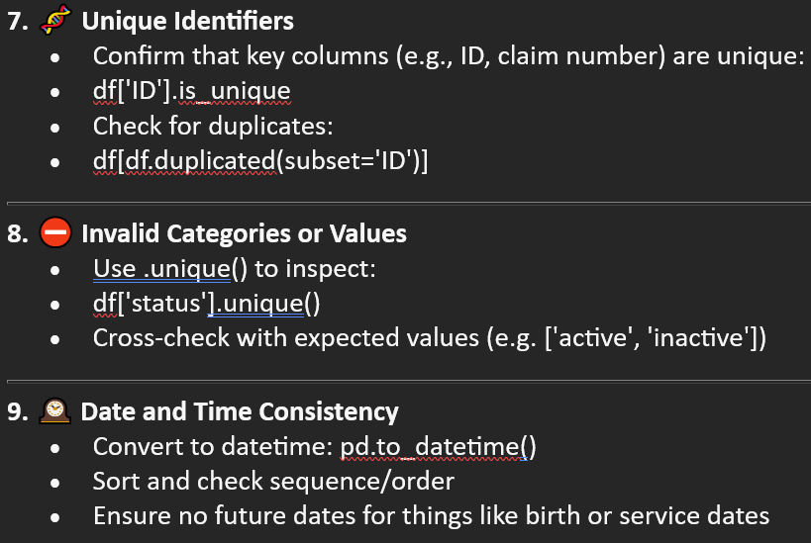
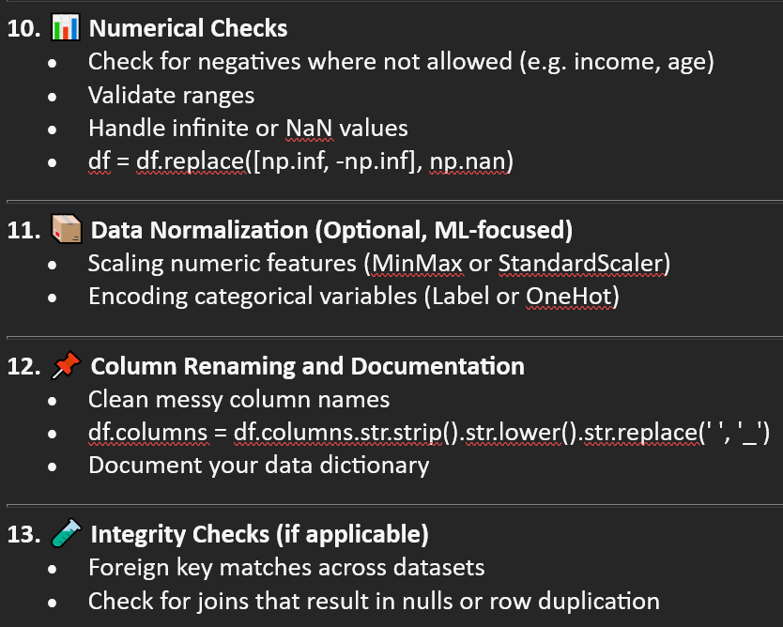
✅ Full List of Data Cleansing / Quality Check Tasks

Slide 6
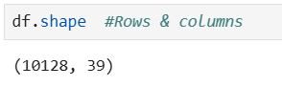
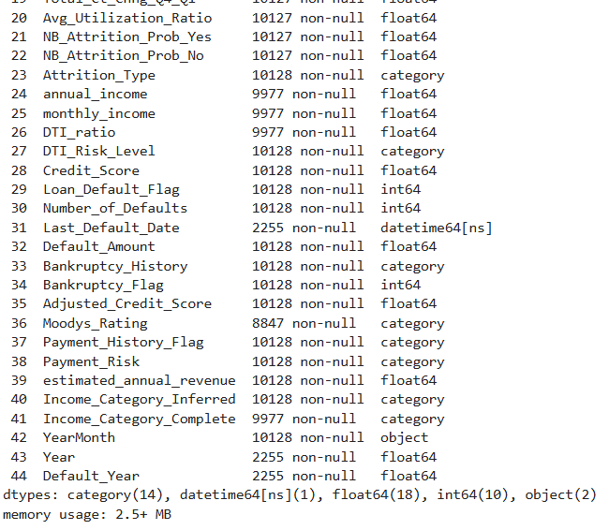
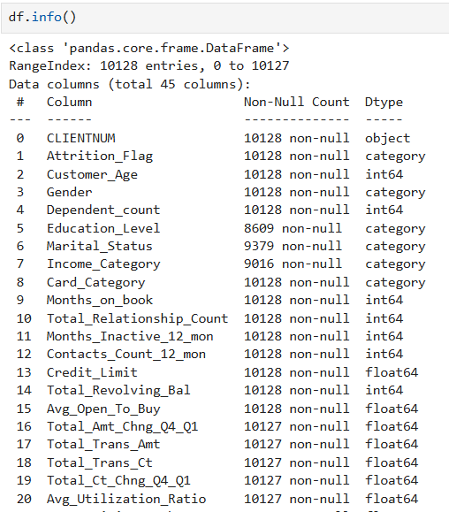

Slide 7
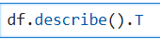
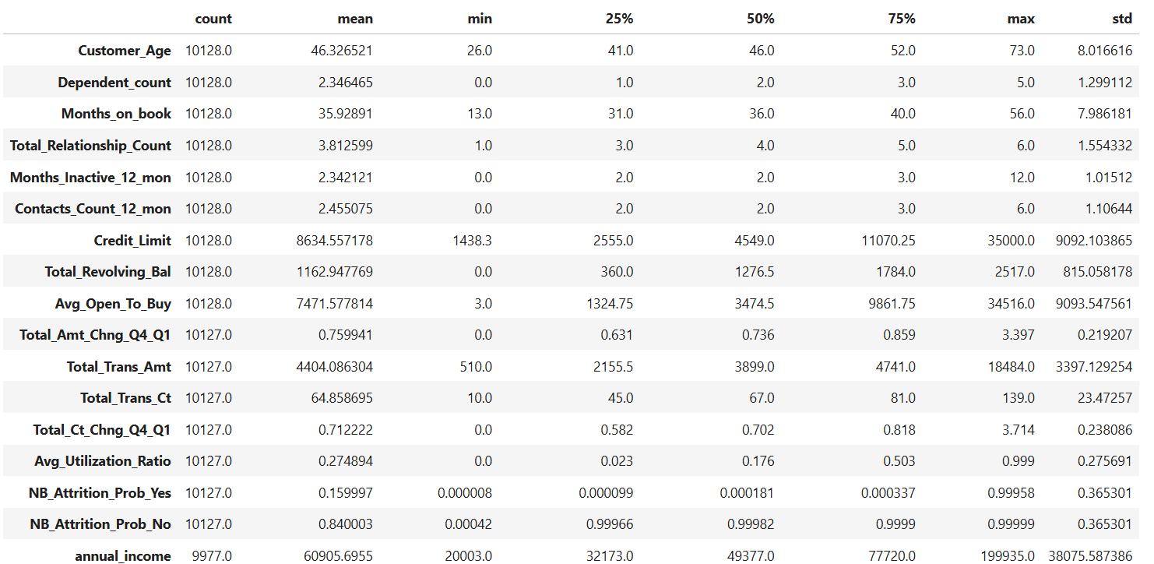

Slide 8
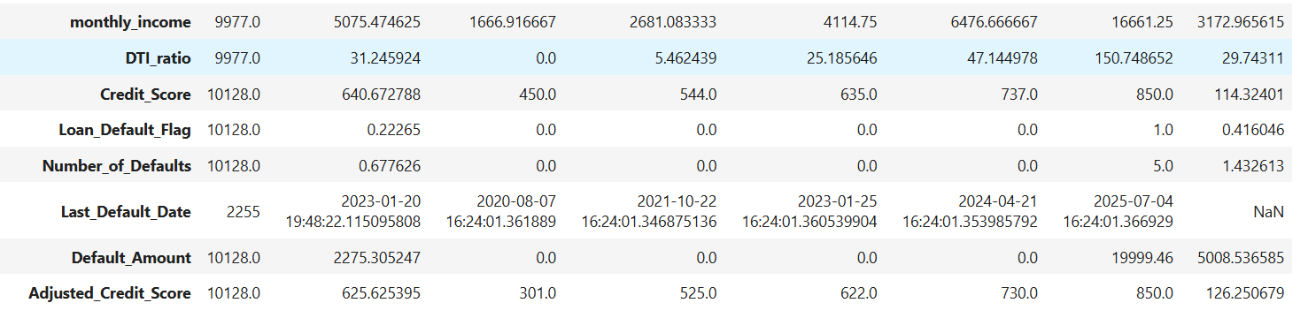

Slide 9
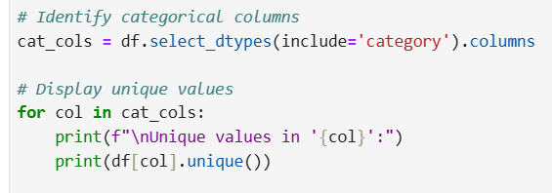
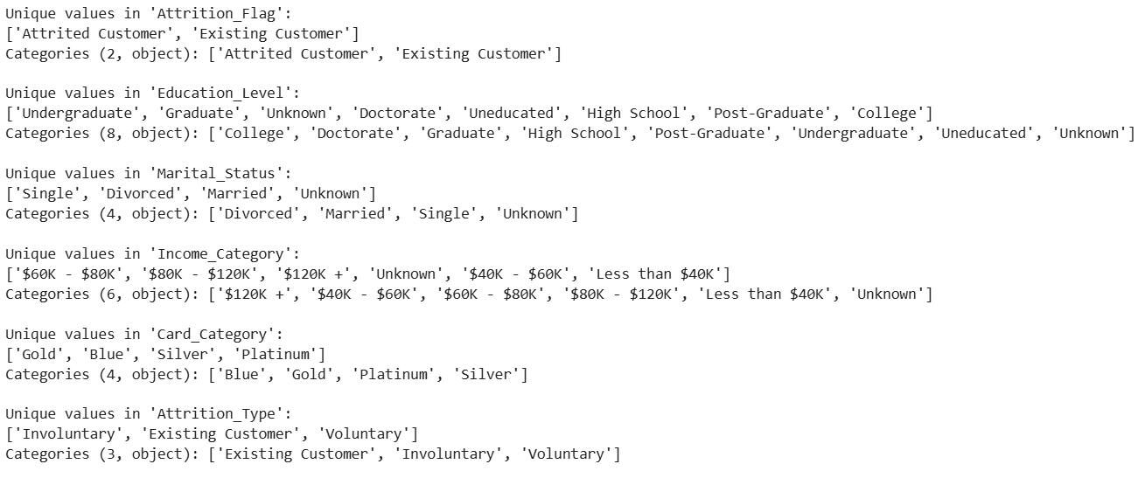
Category Variables

Slide 10
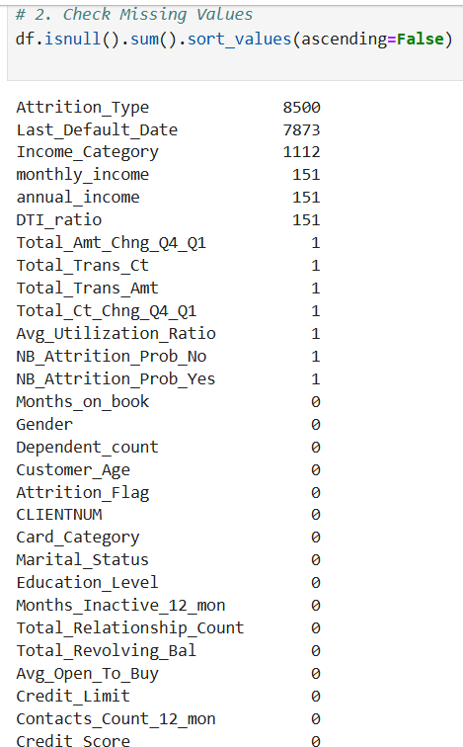
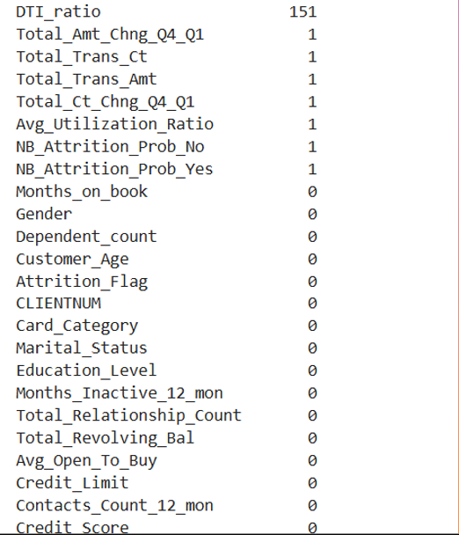
How to fill up missing Income_Categoary?

Slide 11
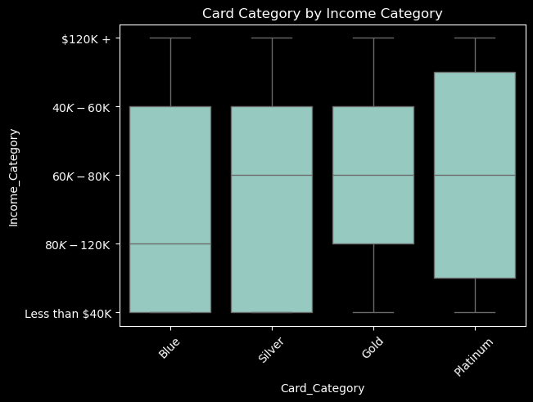
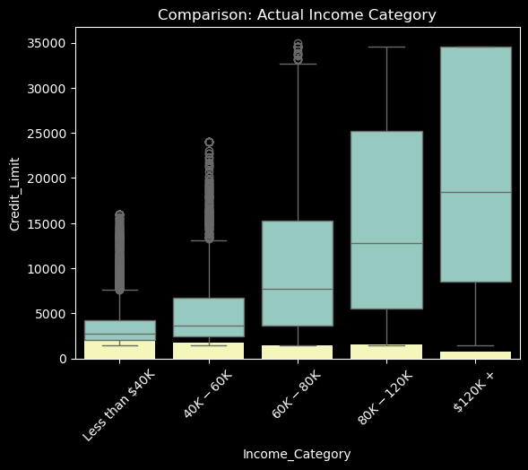
How to fill up missing Income_Category?

Slide 12
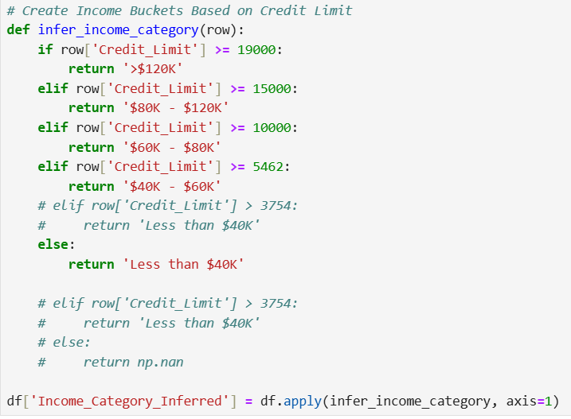
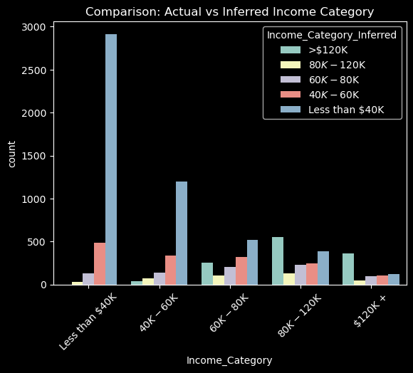
No more missing Income_Categoary!!!

Slide 13
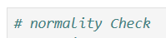
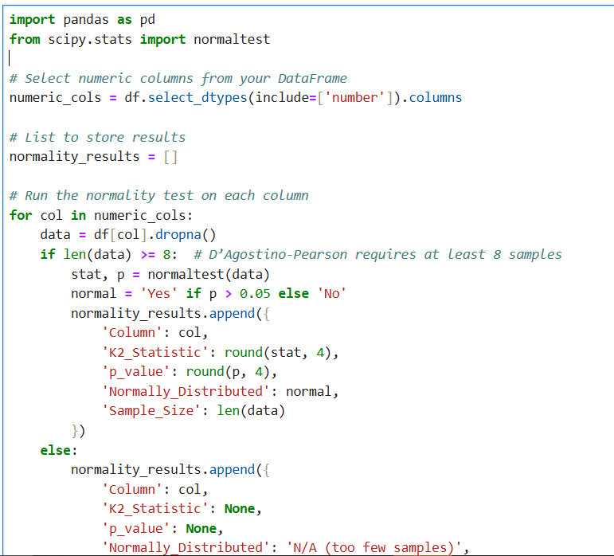
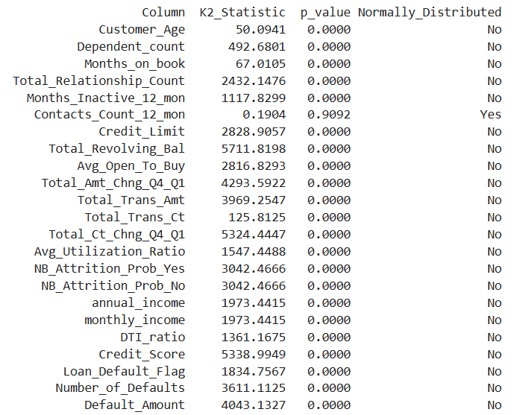
All, except one variable, is not normally distributed.

Slide 14
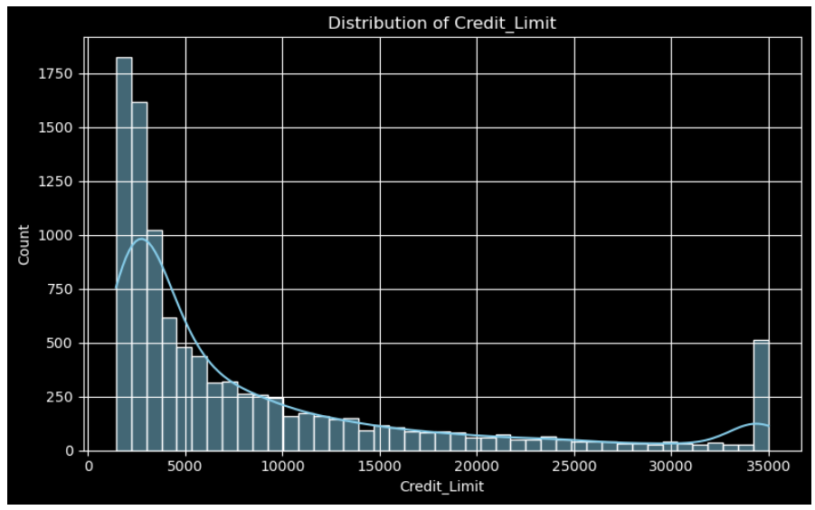
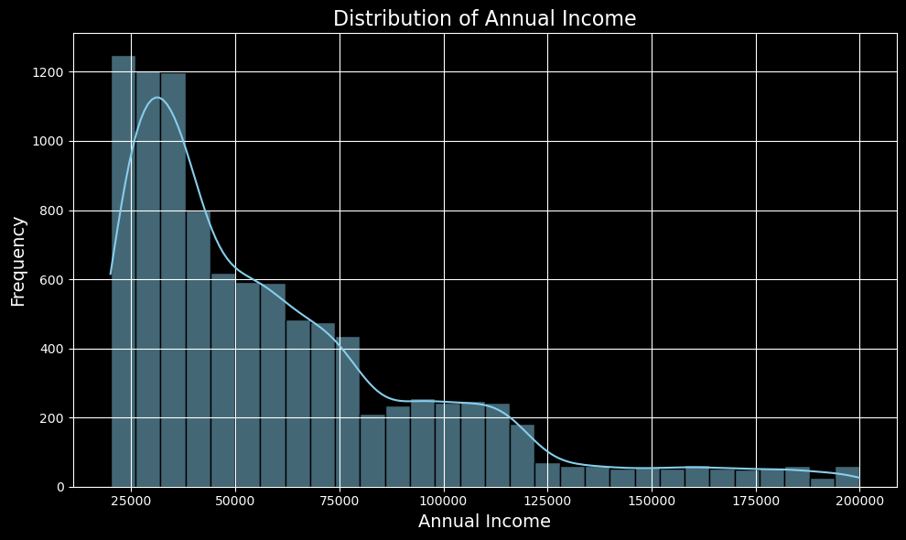
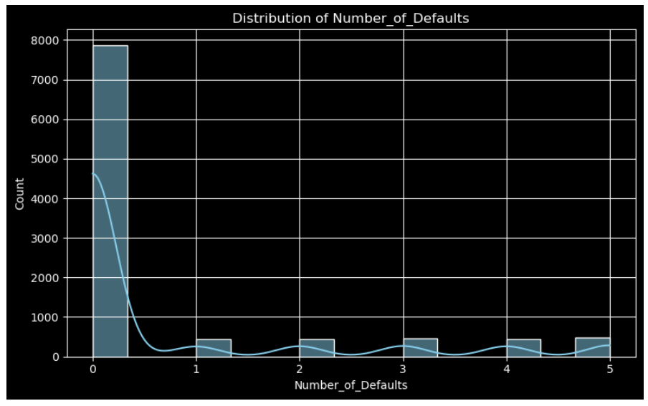
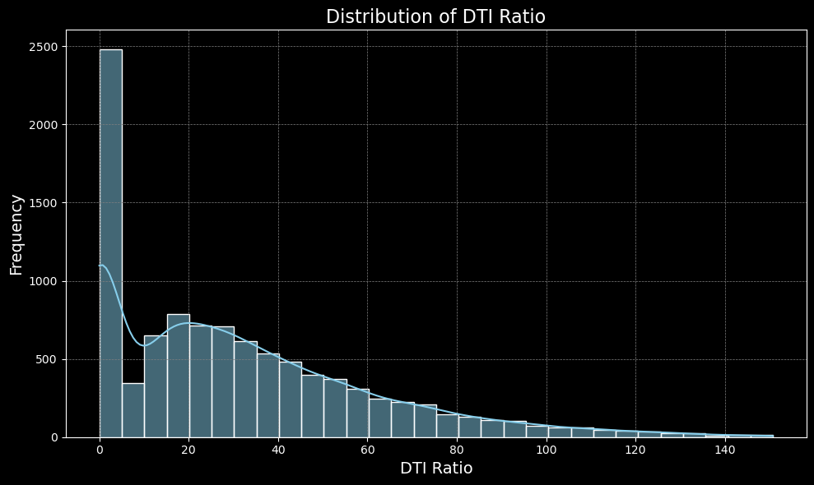

Slide 15
DEBT-TO-INCOME
DTI Ratio= (Total Monthly Debt Payments / Gross Monthly Income ​)×100
DTI Range | Interpretation
0%–20% | Excellent
21%–36% | Good
37%–49% | Risky
50%+ | High Risk

Slide 16
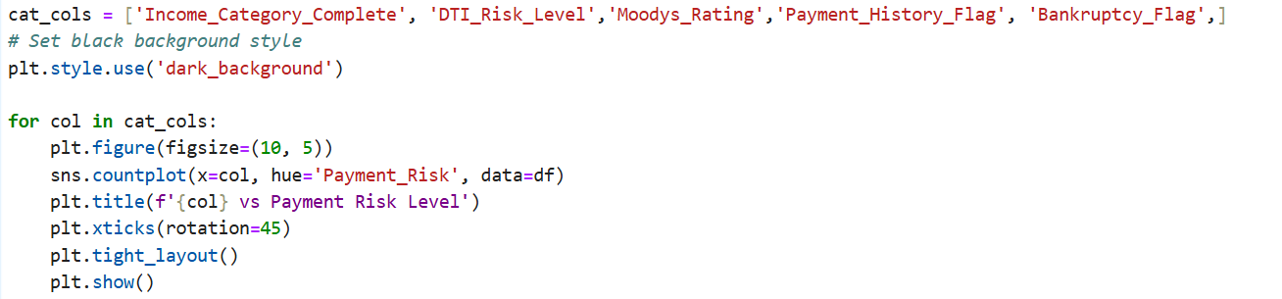
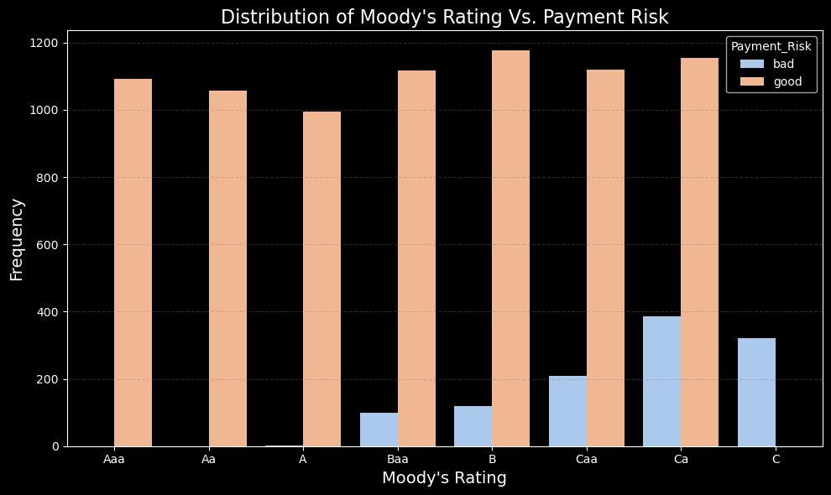
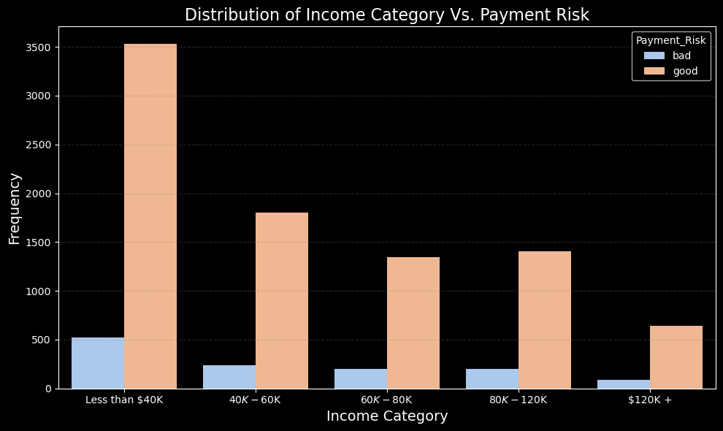

Slide 17
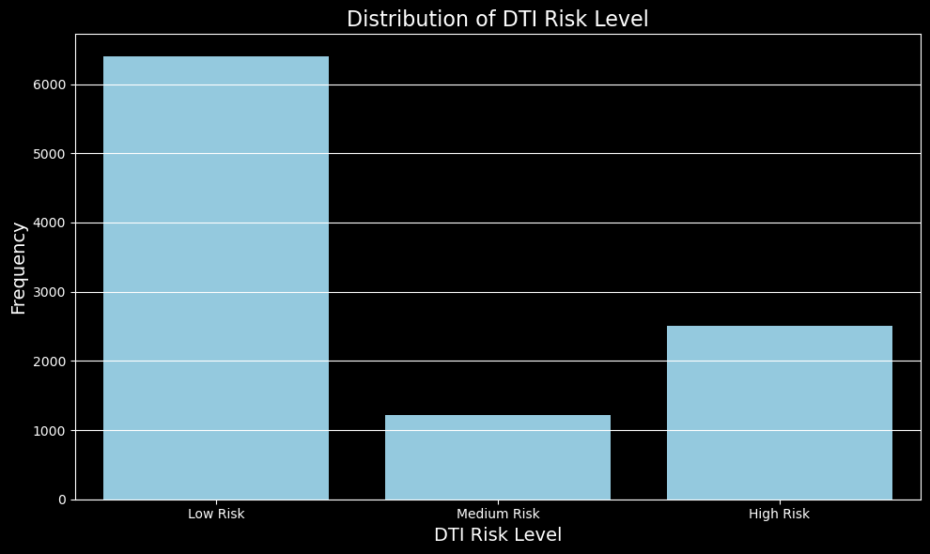
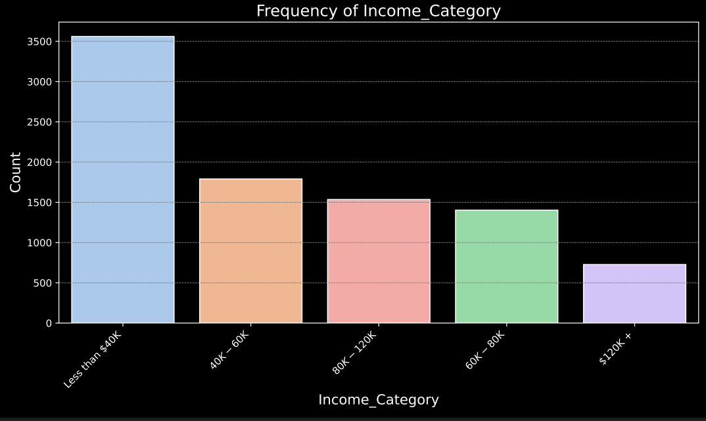

Slide 18
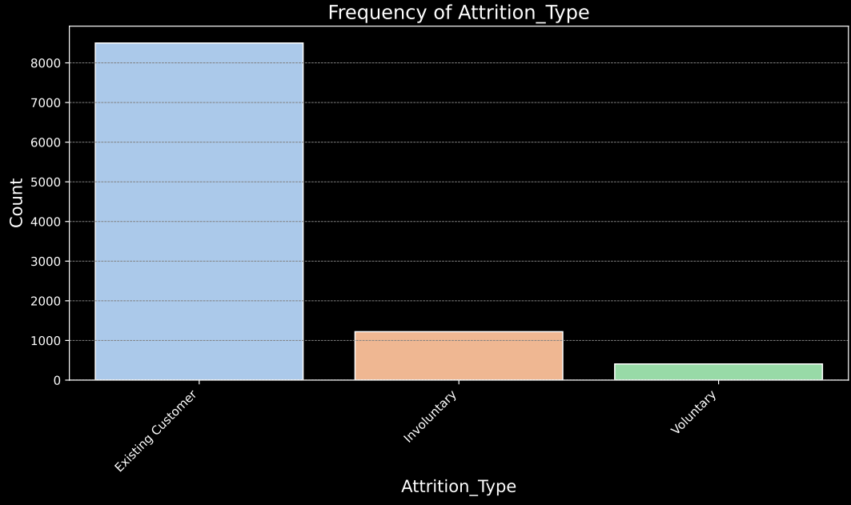
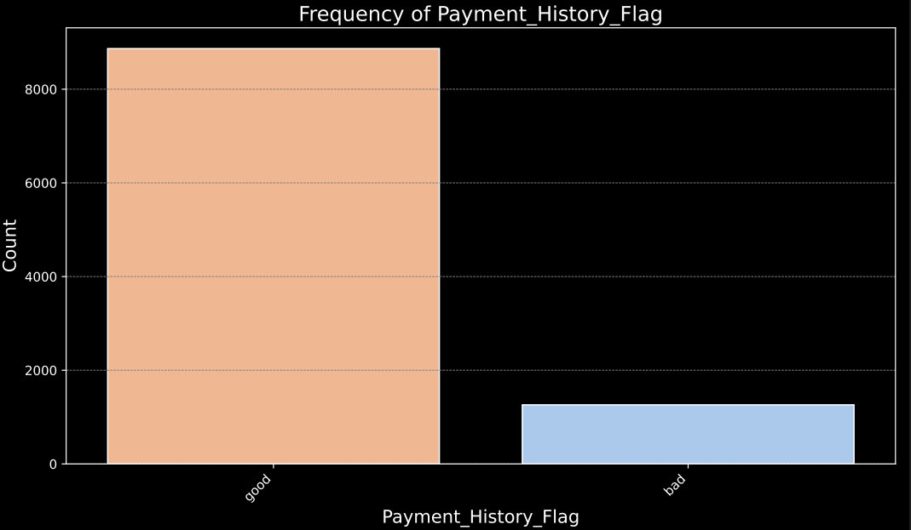
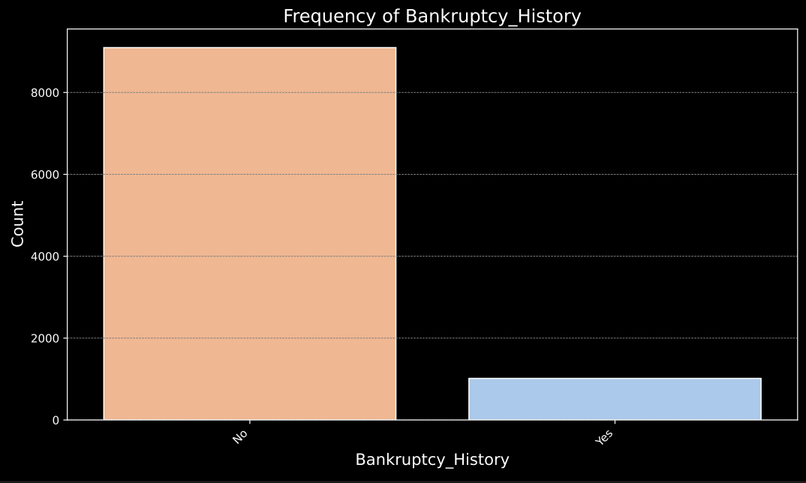
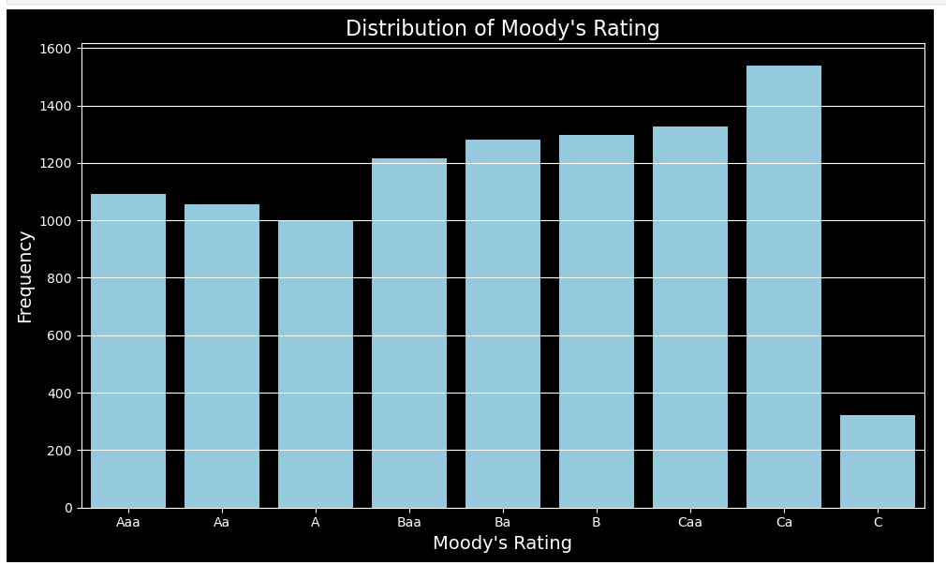
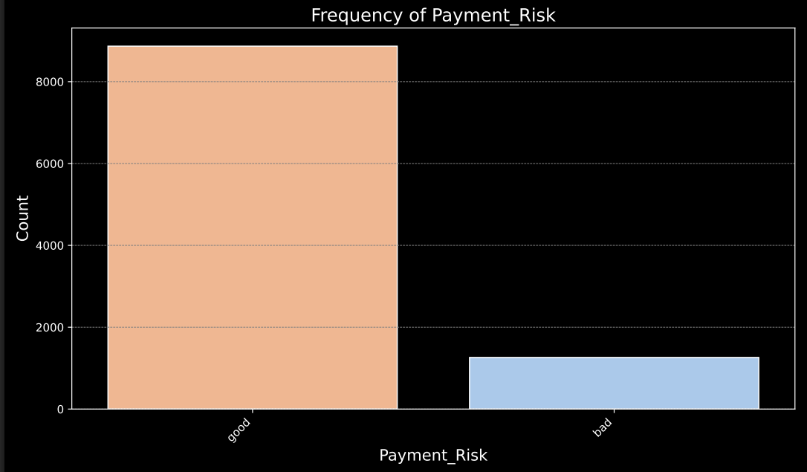
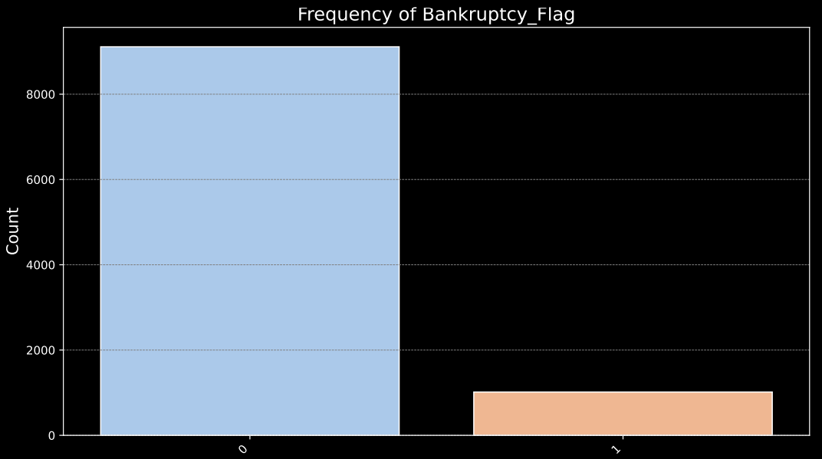

Slide 19
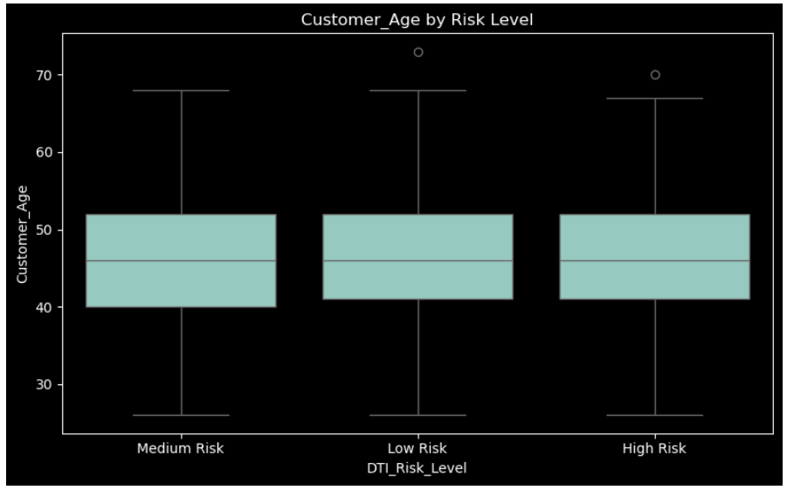
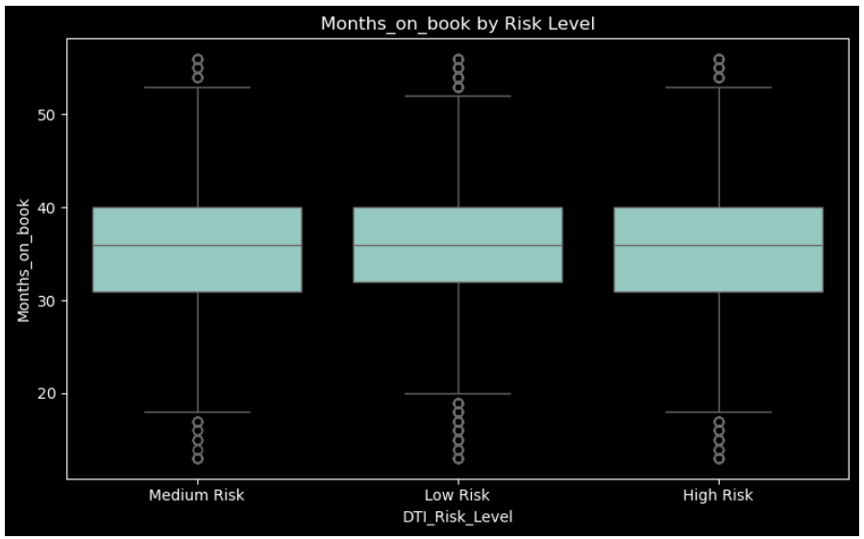

Slide 20
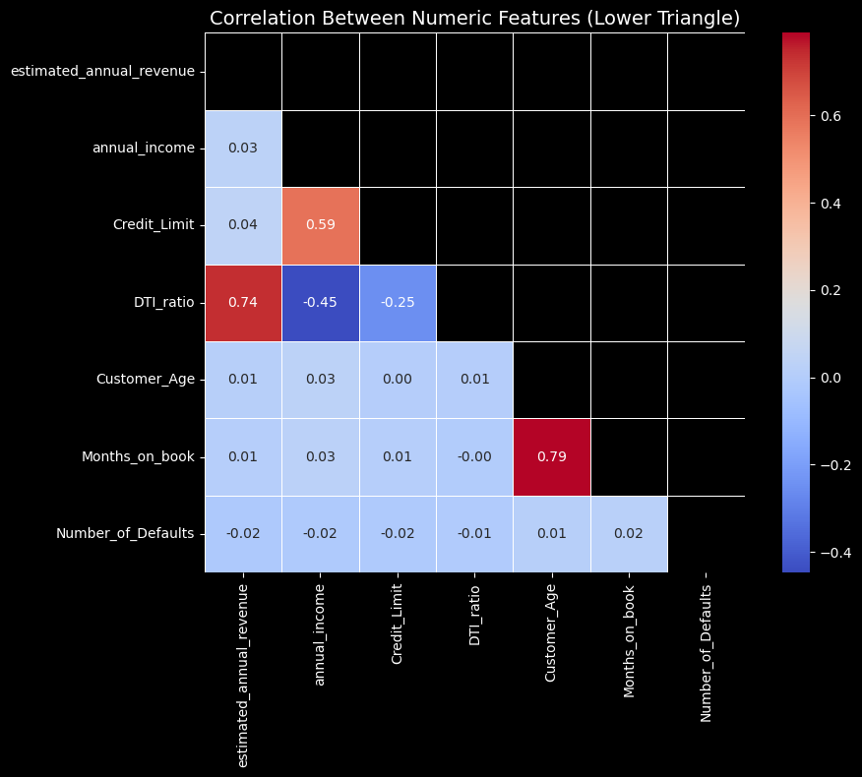
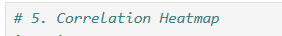
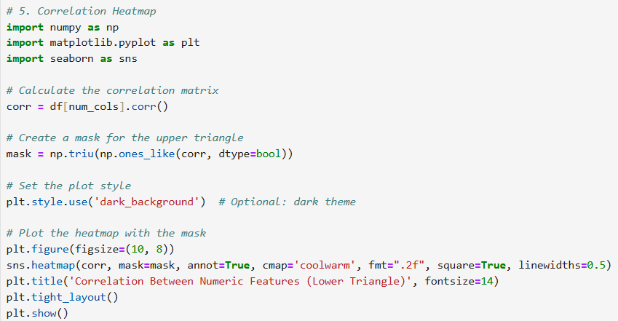

Slide 21
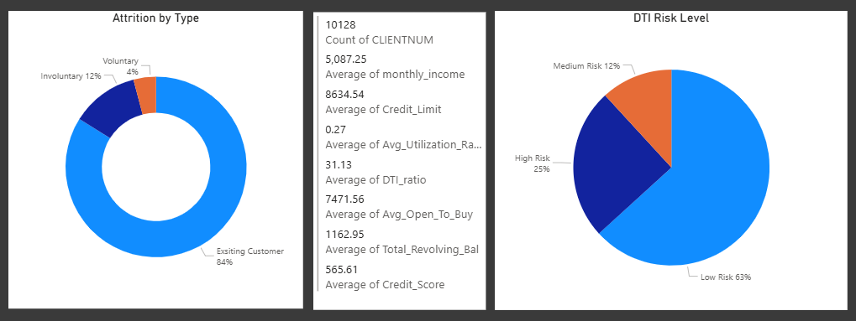
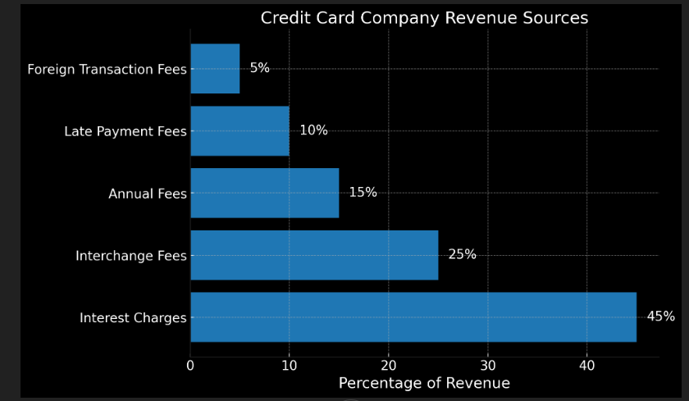
Overall View
Involuntary Attrition Rate | Risk Level
<5% | Healthy
2%~6% | Acceptable
> 10% | Red Flag

Slide 22
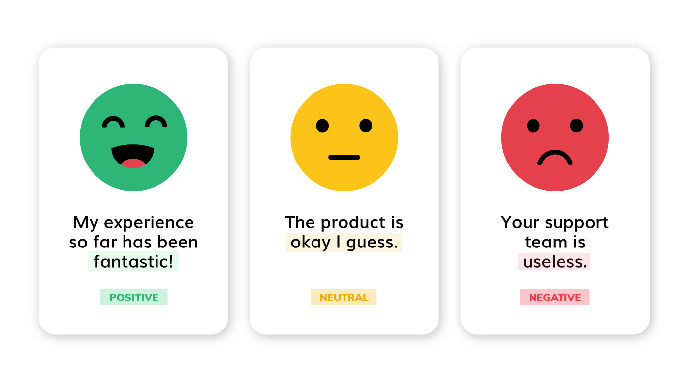
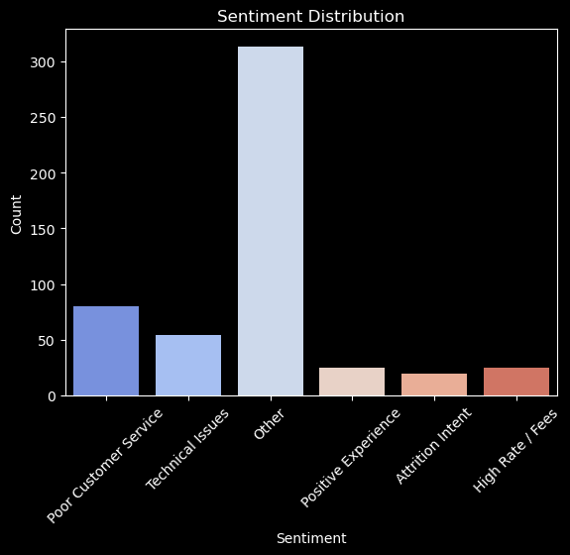
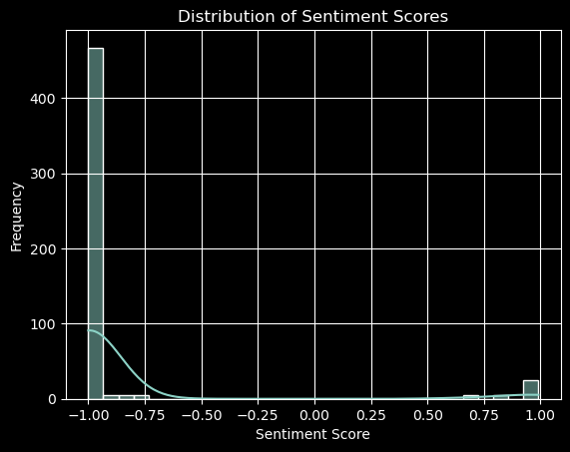
Voluntary Attrition
Sentiment Analysis

Slide 23
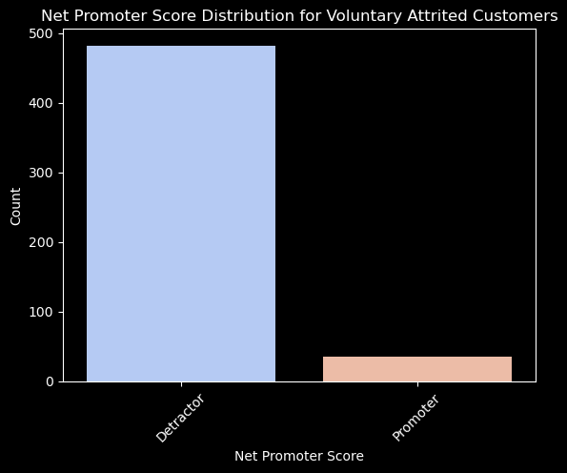
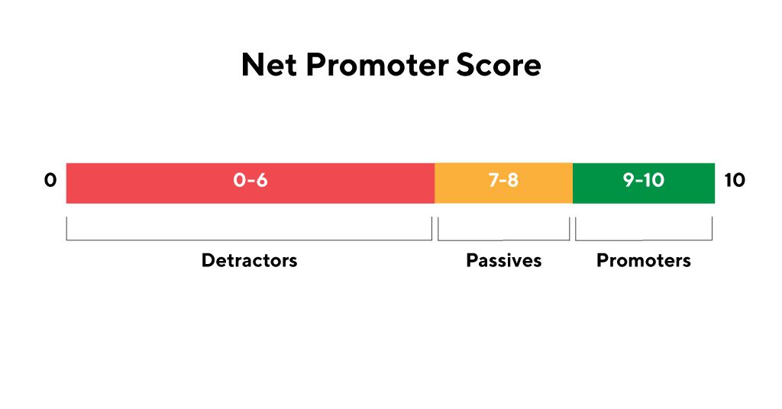
Voluntary Attrition
NPS Analysis
(Net Promoter Score)

Slide 24
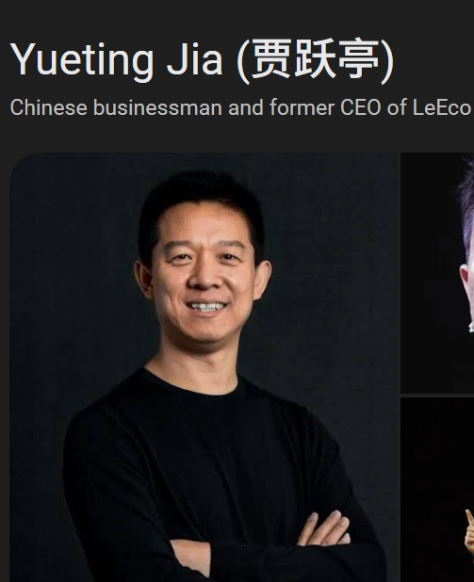
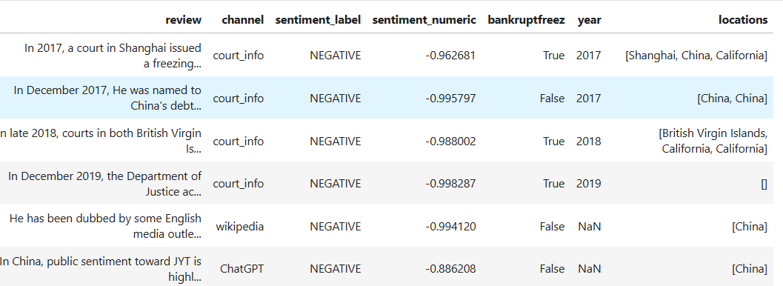
Involuntary Attrition

Slide 25


Involuntary Attrition
Q: How high is credit risk on people like-him/business if we invested?

Slide 26


Slide 27


Slide 28


Client Counts
Estimated Annual Revenue

Slide 29



Slide 30


Slide 31
Thank you all

Slide 32

The power of communication

Slide 33
Overcoming nervousness
Confidence-building strategies

Slide 34

Engaging the audience
Make eye contact with your audience to create a sense of intimacy and involvement
Weave relatable stories into your presentation using narratives that make your message memorable and impactful
Encourage questions and provide thoughtful responses to enhance audience participation
Use live polls or surveys to gather audience opinions, promoting engagement and making sure the audience feel involved

Slide 35
Selecting visual aids
Enhancing your presentation

Slide 36
Effective delivery techniques
This is a powerful tool in public speaking. It involves varying pitch, tone, and volume to convey emotion, emphasize points, and maintain interest.
Pitch variation
Tone inflection
Volume control
Effective body language enhances your message, making it more impactful and memorable.
Meaningful eye contact
Purposeful gestures
Maintain good posture
Control your expressions

Slide 37
Navigating Q&A sessions
Know your material in advance
Anticipate common questions
Rehearse your responses
Maintaining composure during the Q&A session is essential for projecting confidence and authority. Consider the following tips for staying composed:
Stay calm
Actively listen
Pause and reflect
Maintain eye contact

Slide 38
Speaking impact
Your ability to communicate effectively will leave a lasting impact on your audience
Effectively communicating involves not only delivering a message but also resonating with the experiences, values, and emotions of those listening

Slide 39
Dynamic delivery
Learn to infuse energy into your delivery to leave a lasting impression
One of the goals of effective communication is to motivate your audience
Metric | Measurement | Target | Actual
Audience attendance | # of attendees | 150 | 120
Engagement duration | Minutes | 60 | 75
Q&A interaction | # of questions | 10 | 15
Positive feedback | Percentage (%) | 90 | 95
Rate of information retention | Percentage (%) | 80 | 85

Slide 40
Final tips & takeaways
Consistent rehearsal
Strengthen your familiarity
Refine delivery style
Pacing, tone, and emphasis
Timing and transitions
Aim for seamless, professional delivery
Practice audience
Enlist colleagues to listen & provide feedback
Seek feedback
Reflect on performance
Explore new techniques
Set personal goals
Iterate and adapt

Slide 41
Speaking engagement metrics
Impact factor | Measurement | Target | Achieved
Audience interaction | Percentage (%) | 85 | 88
Knowledge retention | Percentage (%) | 75 | 80
Post-presentation surveys | Average rating | 4.2 | 4.5
Referral rate | Percentage (%) | 10 | 12
Collaboration opportunities | # of opportunities | 8 | 10

Slide 42

Thank you
Brita Tamm
502-555-0152
brita@firstupconsultants.com
www.firstupconsultants.com

